Slide 1
Understanding WiFi Channels
Written and presented by:
Genevieve Schreiber

Slide 2
Introduction
WiFi channels are the medium through which your wireless Internet network sends and receives data.[1]
They operate at more specific frequencies within 2.4GHz or 5GHz overarching ranges.
Channels allow multiple networks to work with less interference.

Slide 3
WiFi Frequency Bands
5 GHz
802.11a/n/ac - limited compatibility
up to 45 channels
Covers only a short range (~90 ft indoor)
2.4 GHz
802.11b/g/n - compatible with almost any devices.
up to 11 channels in USA
Covers more distance(~150 ft indoor)

Slide 4
WiFi Channel Overlapping
WiFi Channel overlap is when two WiFi channels have frequency ranges that interfere with one another.
Slows network speeds
2.4GHz has 3 non-overlapping 20 MHz “wide” channels, 11 total channels in USA
5GHz band has 24 non-overlapping channels.

Slide 5
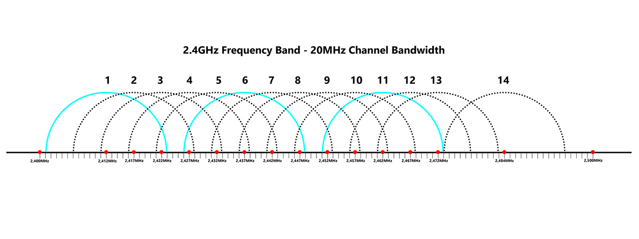
Channel Width 2.4GHz frequency band[5]

Slide 6
Optimizing Network Performance
Plan in a way that minimizes interference
Increase bandwidth

Slide 7
Channel Planning
Prevent interference in enterprises with planning.
Interference and channel planning is why in Europe, there are 13 channels
Uses channels 1,5,9, and 13
Takes advantage of the four-color theorem in mapping
Bad for very close networks use 1-6-11 scheme

Slide 8

1-6-11 channel structure

Slide 9
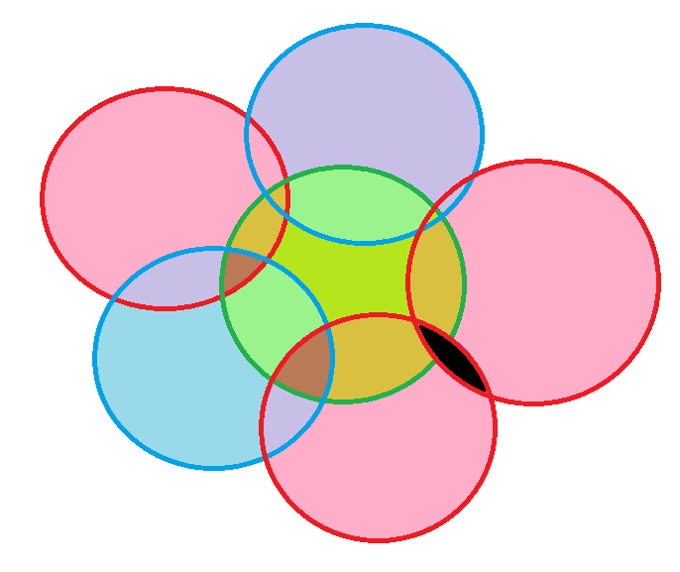
1-6-11 channel structure problems

Slide 10
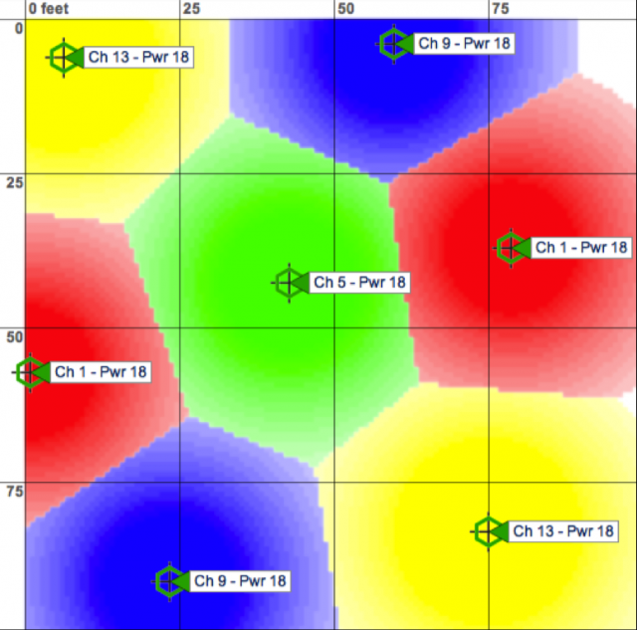
European enterprise network structure [6]

Slide 11
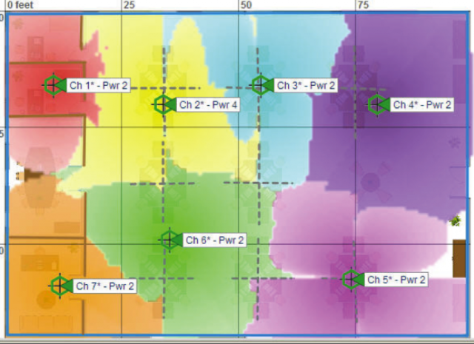
Similar channels next to each other cause interference[6]

Slide 12
Channel Bandwidth
Increasing bandwidth increases speed at the cost of possible interference.
Narrow channel widths are typically used for 2.4GHz
20MHz or rarely 40MHz
Wider channel widths are typically used for 5GHz
40MHz , 80MHz, or 160 MHz

Slide 13
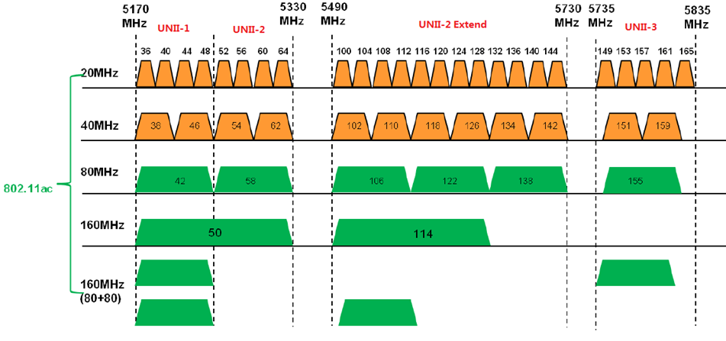
The channels of the 5GHz band[7]

Slide 14
Channel Width 2.4GHz frequency band[5]

Slide 15
Q&A

Slide 16
sources
“WIFI network channels explained and how WIFI is affected?,” Hitron Americas, 03-Aug-2021. [Online]. Available: https://us.hitrontech.com/blog/what-are-network-channels-and-how-does-it-affect-my-wifi/#:~:text=Network%20channels%2C%20or%20WiFi%20channels,and%20are%20able%20to%20use.
“Why channels 1, 6 and 11?,” MetaGeek. [Online]. Available: https://www.metageek.com/training/resources/why-channels-1-6-11/.
S. Albano, “WIFI channels explained,” Minim, the residential managed WiFi and IoT security platform. [Online]. Available: https://www.minim.com/blog/wifi-channels-explained.
“Designing a dual-band Wireless Network,” MetaGeek. [Online]. Available: https://www.metageek.com/training/resources/design-dual-band-wifi/.
B. Mark, “Does the WIFI channel matter? A guide to which channel you should choose.,” MBReviews, 20-Sep-2022. [Online]. Available: https://www.mbreviews.com/does-the-wifi-channel-matter/#overlapping. [Accessed: 20-Mar-2023].
D. Coleman, “2.4 ghz channel planning,” Extreme Networks, 31-Oct-2022. [Online]. Available: https://www.extremenetworks.com/extreme-networks-blog/2-4-ghz-channel-planning/.
“Knowledge base how to optimize wireless performance of EAP Products,” TP. [Online]. Available: https://community.tp-link.com/en/business/forum/topic/164112.

